Slide 1
Document Control
By Using
Object Detection
MINOR PROJECT:
By MRIGANK SINGH (A7605217004)
Guide: DR. SHEENU RIZVI
Assistant Professor
Amity School of Engineering and Technology

Slide 2
This project’s aim is to help people control their Power Point Presentations (PPT) and Portable Document Format (PDF) files through their hand gestures, instead of using a mouse or any other pointing device.
This would mostly aid in accessibility and provide mobility to the presenter.
What is this project about?
What is the use of the project?

Slide 3
TABLE OF CONTENTS
1.
4.
2.
5.
3.
6.
INTRODUCTION TO ARTIFICIAL INTELLIGENCE
OPENCV AND PYAUTOGUI
COMPUTER VISION
IMPLEMENTATION OF THE PROJECT
OBJECT DETECTION
FUTURE SCOPE

Slide 4
1
ARTIFICIAL INTELLIGENCE
And all the magic it creates...

Slide 5
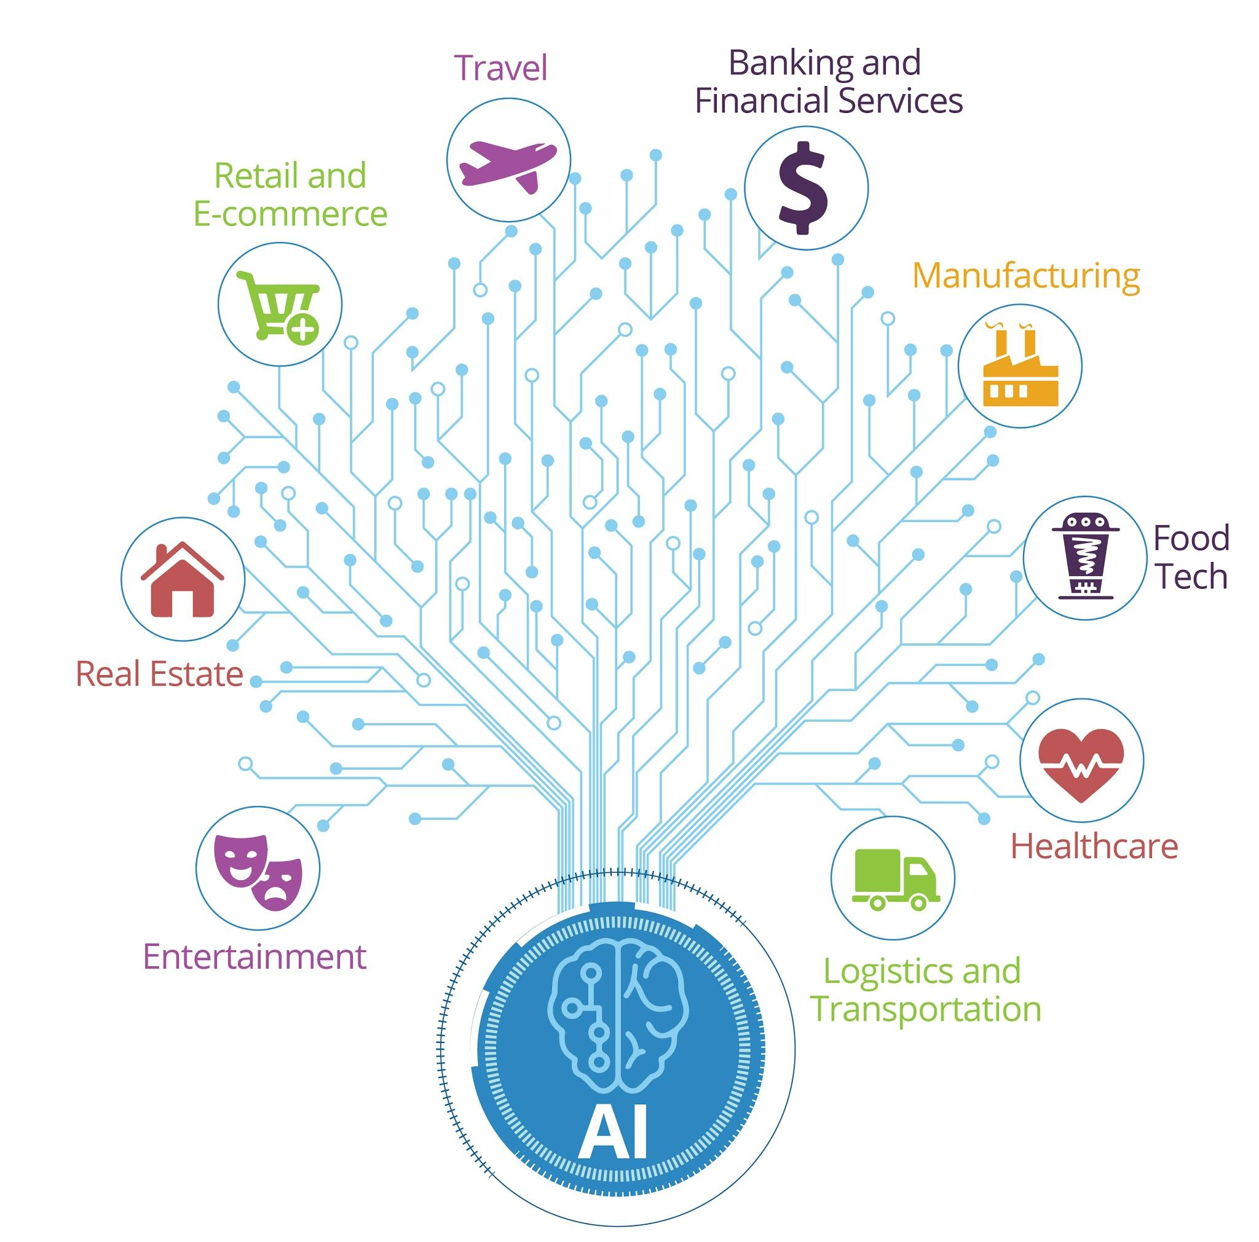
WHAT IS ARTIFICIAL INTELLIGENCE AND WHY ARE WE SO AMAZED BY IT?
Artificial Intelligence is the reproduction of human intelligence in machines with the goal to make them think and copy the human mind.
Artificial Intelligence is continuously evolving so that many different industries are benefited from it. Machines are wired using a cross-disciplinary approach based in mathematics, computer science, linguistics, psychology, and more.

Slide 6
2
COMPUTER VISION
What makes machines see the world, like humans!

Slide 7

WHAT IS COMPUTER VISION EXACTLY?
It deals with modeling and replicating human vision using computer software and
hardware.
Formally, it can be defined as:
A discipline of Artificial Intelligence that explains how to reconstruct, interrupt, and understand a 3-Dimensional scene from its 2-Dimensional images, in terms of the properties of the structure present in the scene.

Slide 8
APPLICATIONS OF COMPUTER VISION
Image Processing
Pattern Recognition
Photogrammetry
This focuses on image handling or image manipulation .
This explains various techniques to identify and classify patterns.
This is concerned with obtaining accurate measurements and dimensions from images.
HOW IS IT USED IN INDUSTRY?
01
Robotics
Navigation
Obstacles avoidance
Assembly
02
Medicine
3-Dimensional human organ reconstruction (MRI or ultrasound)
Vision-guided robotics surgery
03
Security and Transportation
Biometrics (iris, fingerprint, face recognition)
Autonomous vehicle

Slide 9
3
OBJECT DETECTION
It’s amazing when a machine does it!

Slide 10
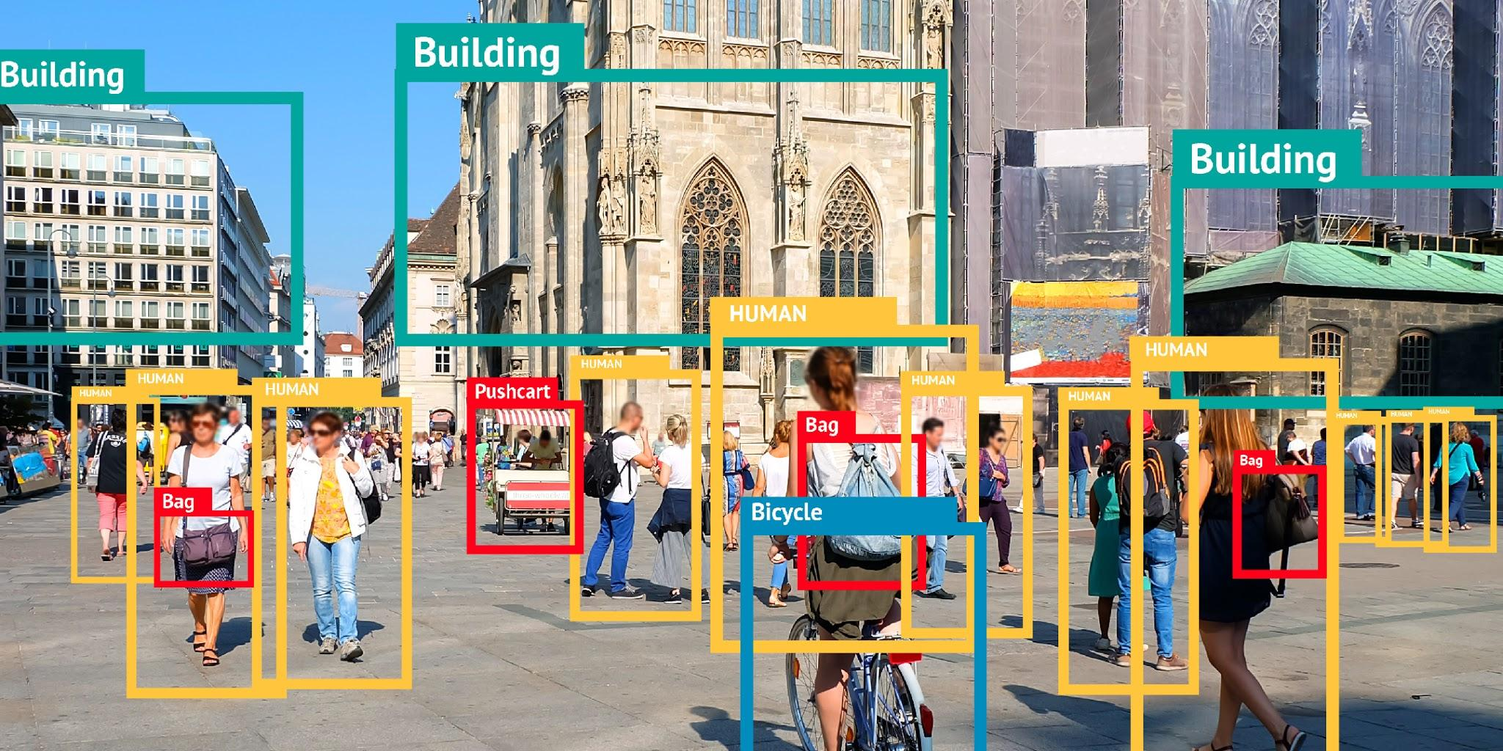
OBJECT DETECTION
Object detection is a Computer vision procedure that helps in finding and distinguishing objects in a picture or a video.
With the assistance of Object Detection, we can include the quantity of articles in a picture, recognize the sort of article appeared in the picture (for instance, a tree or a dog, and so on), or decide the exact area of any article with precise naming.

Slide 11
4
OPENCV AND PYAUTOGUI
They make the magic happen!

Slide 12


OPENCV
PYAUTOGUI
OpenCV is the acronym for Open Source Computer Vision Library.
Used mainly for live Computer Vision in real-time.
It is a cross-platform library, which means that it can run on different platforms easily.
PyAutoGUI is a Python package that lets us control our mouse and keyboard so as to automate their tasks with other applications.
The package is compatible and runs on Windows, macOS, and Linux.

Slide 13
5
IMPLEMENTATION OF THE PROJECT

Slide 14

STARTING WITH THE BASICS
The very first task that was needed to be done was to import all the necessary libraries into our project file.
Cv2 is the OpenCV library.

Slide 15

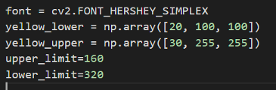
The next step was to start capturing video from our webcam. For doing this, we would require OpenCV.
OpenCV has functions ranging from the basics, that is, detecting a camera device, to highly complex processes, that is, object and motion detection.
After we have successfully started capturing the video feed from our webcam, we need to distinguish the colors in the current frame, so as to identify the object from the surrounding objects and the background.

Slide 16

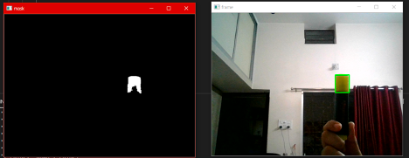
In the next step I converted this particular read frame into HSV color format to get more precise results. After converting the color format, it needs to be masked it so that the computer only sees the color we want it to see.
The image below shows the result of the frame after masking. It can be noticed from the image above that every color except the neon yellow color is masked out or ignored.

Slide 17
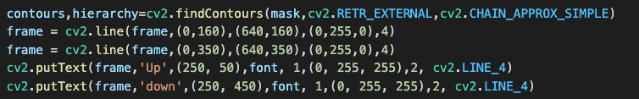
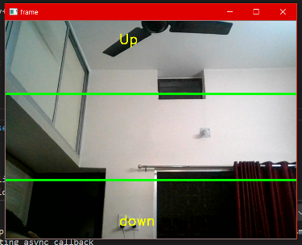
The noise in the frame needs to be reduced, and hence contours need to be enabled.
I have also drawn lines of the specified dimensions and colour, to demarcate the “region of interest” in the frame.
The user should also be prompted which region is used for which particular action.

Slide 18
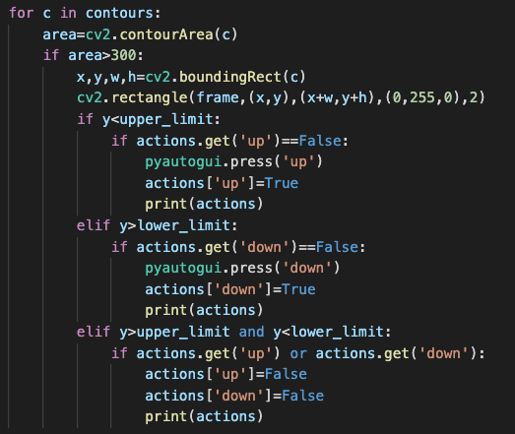
Coming to the final step of the project, I had to implement the actions part. This will tell the system what action needs to be performed and when it needs to be performed.
The coordinates of the rectangles drawn on the frame would come in handy for this particular task. We need its y-coordinate to know the region of the object detection in our frame, also known as the “region of interest”.

Slide 19
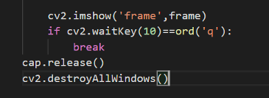
AND FINALLY….
We want to close the application as per our convenience and we do not want it to run endlessly, so we can press “q’ on the keyboard to close the frame window, and all the frames opened by the program.

Slide 20
6
FUTURE SCOPE OF THE PROJECT

Slide 21
FUTURE SCOPE
This project would be further extended to perform more complex functions and also to control documents such as PowerPoint Presentations and Portable Document Format (PDF) files. This project was just a small example to show the foundation of the more complex operations it is capable of performing. As another example, it can also be used to control actions in a video game and thus be used in motion sensing.

Slide 22
REFERENCES
https://www.fritz.ai/object-detection/
https://www.circuitdigest.com
https://www.dx.doi.org
ACM Press SIGGRAPH Asia 2014 Courses- Shenzhen, China (2014.12.03-, by Angel, Ed Shreiner- 2014
IEEE 2015 ITU Kaleidoscope Trust in the Information Society
IEEE 2016 IEEE 21st International Conference on Emerging Technologies
IEEE 2018 International Conference on Advances in Computing and Com, by McInnis, Schillaci- 2018

Slide 23
THANK YOU!

